Slide 1

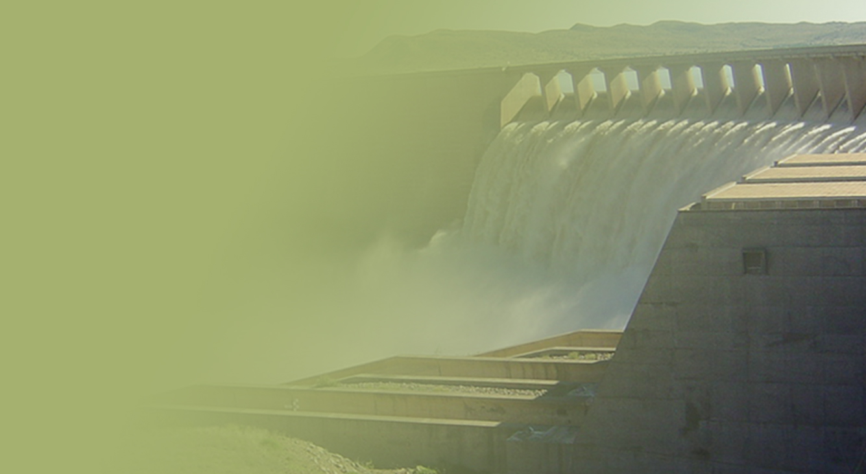
Support of the Water Reconciliation Strategy for the Algoa Water Supply System
SSC Meeting
Aurecon
18 April 2018
PRESENTATION TITLE
Presented by:
Name Surname
Directorate
Date

Slide 2
Darlington Dam water quality time series

Slide 3
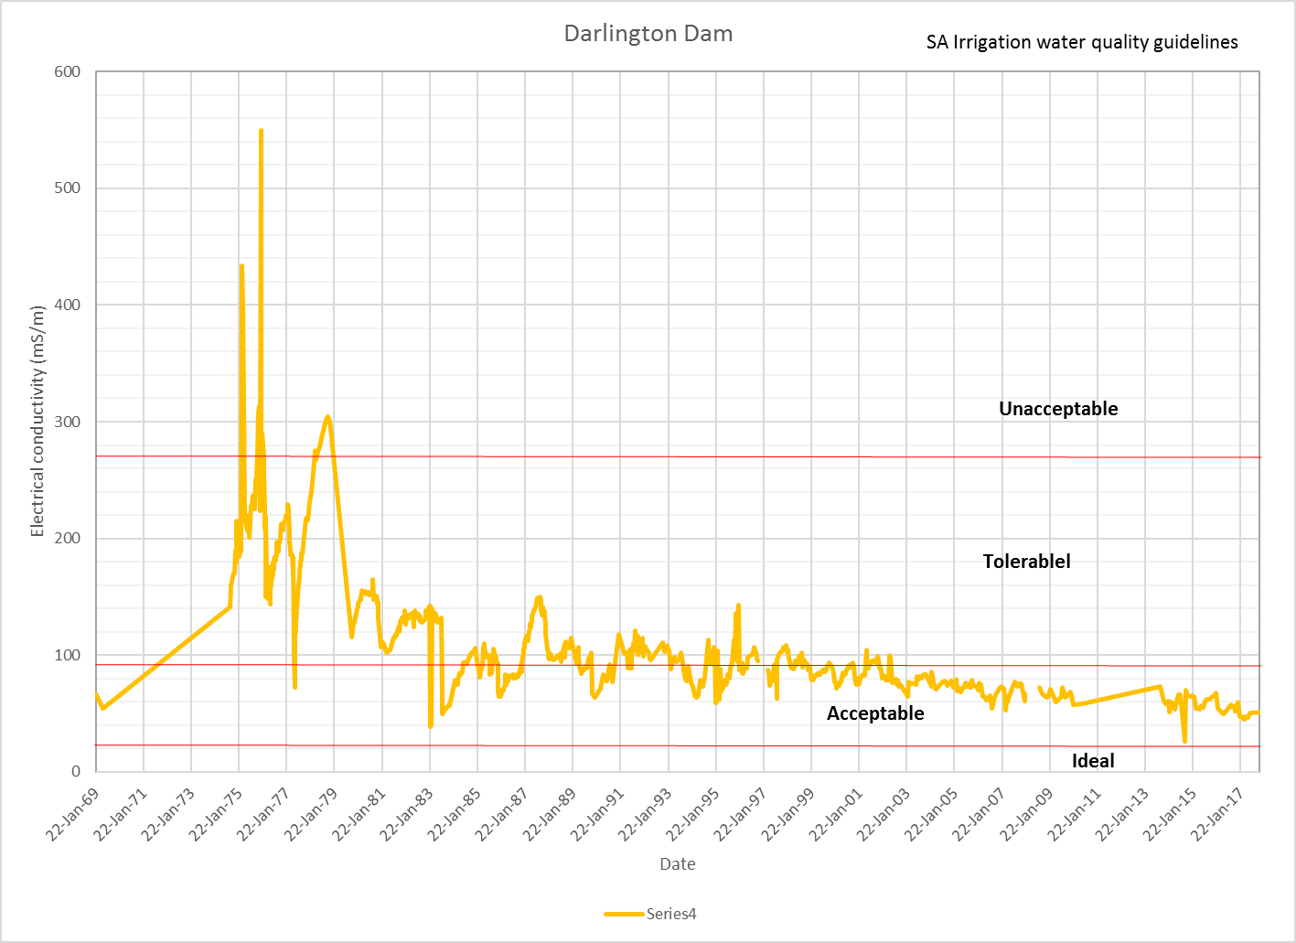
Electrical conductivity time series

Slide 4
TDS time series

Slide 5
Feasibility evaluation: Additional balancing storage in the LSRGWS

Slide 6
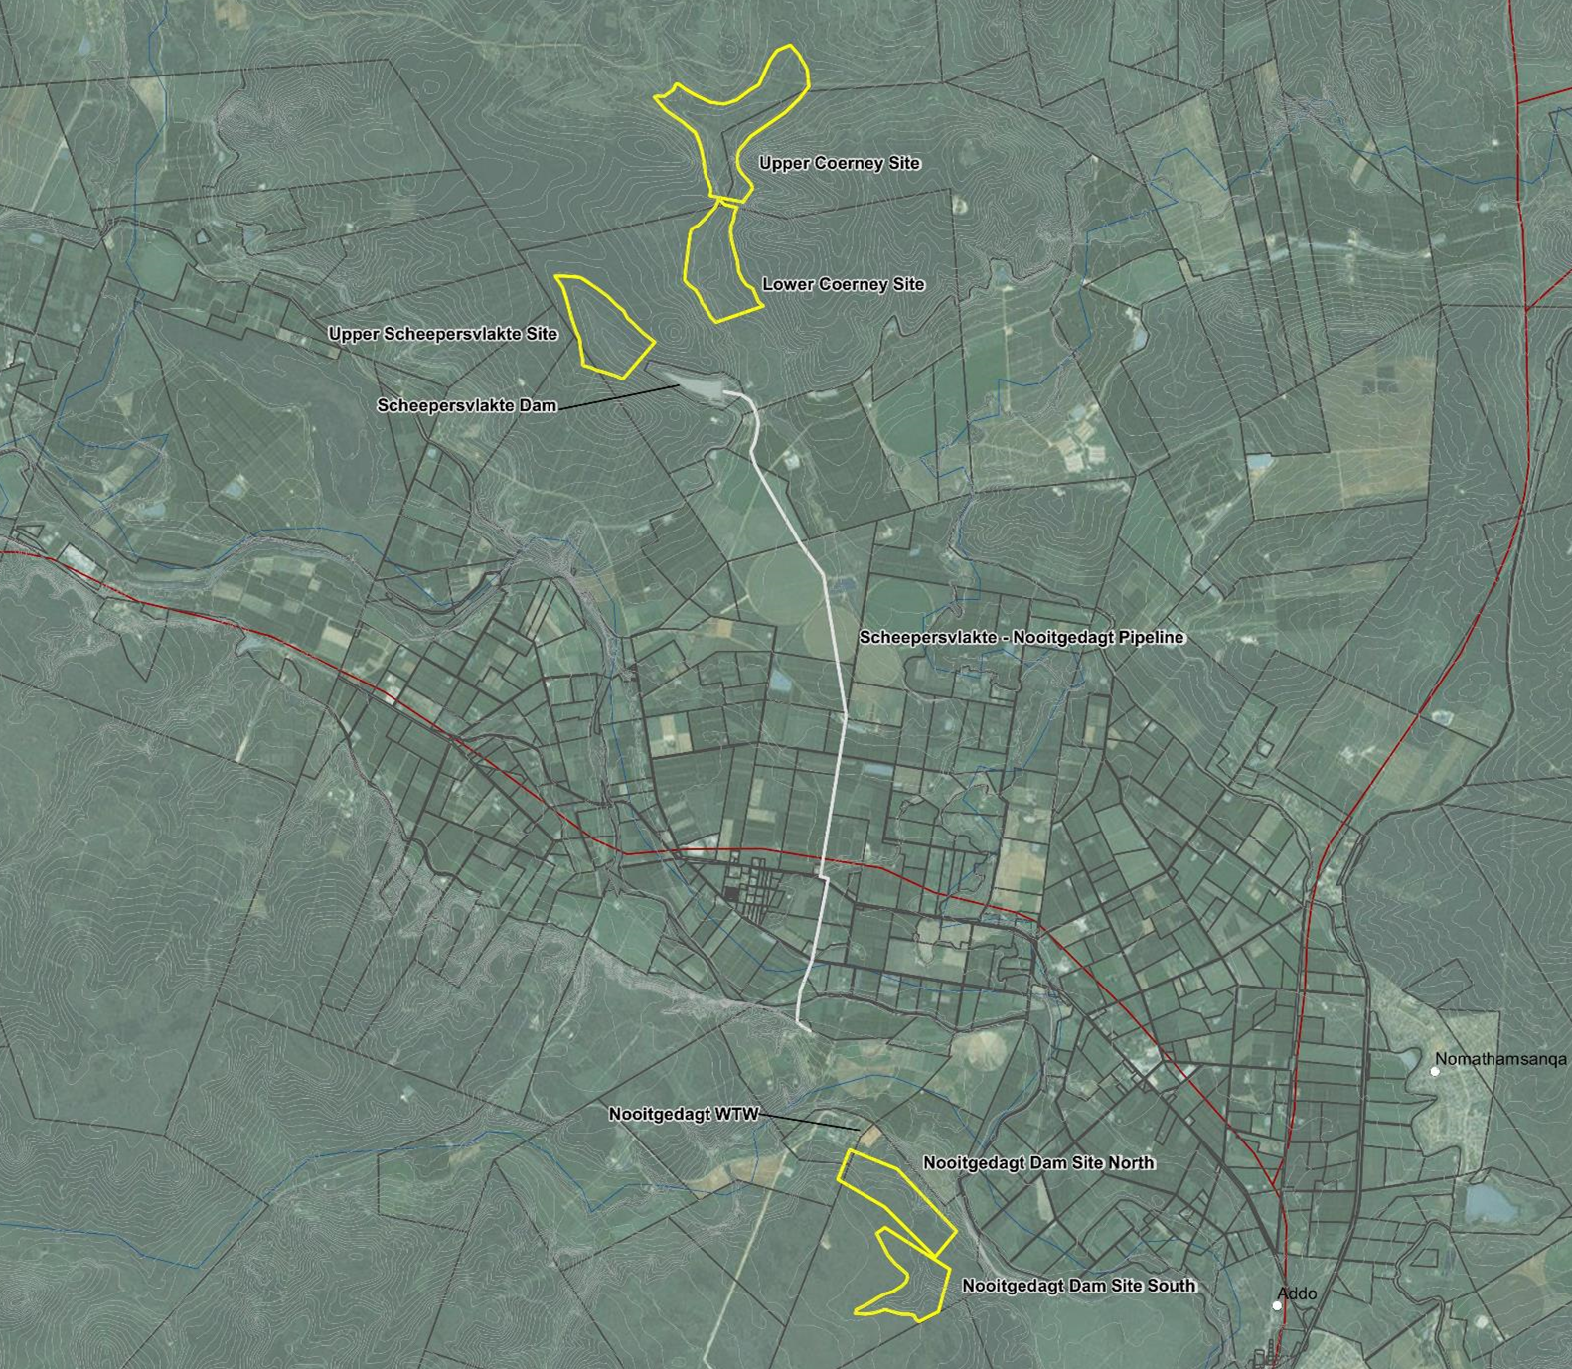
Short-listed Options
Upper Coerney
Lower Coerney
Upper Scheepersvlakte
Scheepersvlakte Dam
Scheepersvlakte – Nooitgedagt pipeline
Nooitgedagt WTW
Nooitgedagt North
Nooitgedagt South
Notes:
Options in the vicinity of Scheepersvlakte Dam as follows:
Measures to reduce the risk of a failure of the 1400 mm pipeline from Scheepersvlakte to Nooitgedagt, which would be required together with each of the ‘Scheepersvlakte Dam’ options below.
Raising of Scheepersvlakte Dam.
Upper Scheepersvlakte Dam, which would be sited upstream of the existing Scheepersvlakte Dam, and would impact on the planned Scheepersvlakte Farms private irrigation development.
Lower Coerney Dam, which would be shared with the Scheepersvlakte Farms private irrigation development.
Upper Coerney Dam.
Alternative sites for a balancing dam on the right bank near the Nooitgedagt WTW.

Slide 7
Preparatory work done
Dam sizing – 4.4 Mℓ, 21 days ADD storage
Identification & preliminary screening of dam sites
Site visit 9 -10 October 2017:
      Successful meeting held with the land owners of the land on which the potential dam sites fall
      Viewing of the potential dam sites
Operating rules for various dam sites established
Additional potential dam sites identified
Environmental Constraints Analysis done
Desktop evaluation & Costing of dams done
2 dams selected for Geotech & Topo surveys
Notes:
21 days - This is based on the risk of failure of the old canal systems, as highlighted by the recent failure of a 100 m long section of the main canal on 17 May 2017, as well as the age of the Korhaansdrift Weir structure.

Slide 8
Comparison of Options
 | Potential dam sites
EVALUATION FACTOR | Upper Scheepers. | Lower Coerney | Upper Coerney | Nooit. North - Option 1 | Nooit. South
Capital cost (R mill) | R349 | R237 | R375 | R457 | R654
Capital cost (pumps cost reduced by 50%) (R mill) | R282 | R231 | R309 | R403 | R600
Cost | 2 - 2nd lowest | 1 - Lowest | 3 - 3rd lowest | 4 - High | 5 - Very High
Pumping required | X |  | X | X | X
Operational complexity | X | X
Strategic location near WTW |  |  |  | X | X
Ecological considerations (Reserve) |  | X but likely easy to address | X but likely easy to address
Consideration of floods |  | X | X
Environmental & social impacts | Limited differentiation | Limited differentiation | Limited differentiation | Limited differentiation | Limited differentiation
Notes:
Based on the cost comparison and other considerations, the two Nooitgedagt dam sites should not be evaluated further, because of their significantly higher cost and other disadvantages. These sites would however have a strategic advantage when compared with the Upper Scheepersvlakte and Coerney dam sites. The risk of failure of these options can be mitigated by providing an additional siphon through the Sundays River , as well as managing the process for quick pipe replacements should it be required.

Slide 9
Comparison of Options
 | Potential dam sites
EVALUATION FACTOR | Upper Scheepers. | Lower Coerney | Upper Coerney | Nooit. North - Option 1 | Nooit. South
Capital cost (R mill) | R349 | R237 | R375 | R457 | R654
Capital cost (pumps cost reduced by 50%) (R mill) | R282 | R231 | R309 | R403 | R600
Cost | 2 - 2nd lowest | 1 - Lowest | 3 - 3rd lowest | 4 - High | 5 - Very High
Pumping required | X |  | X | X | X
Operational complexity | X | X
Strategic location near WTW |  |  |  | X | X
Ecological considerations (Reserve) |  | X but likely easy to address | X but likely easy to address
Consideration of floods |  | X | X
Environmental & social impacts | Limited differentiation | Limited differentiation | Limited differentiation | Limited differentiation | Limited differentiation
The risk of failure of these options can be mitigated by providing an additional siphon through the Sundays River, as well as managing the process for quick pipe replacements should it be required.
The two Nooitgedagt dam sites should not be evaluated further due to their significantly higher capital cost and other disadvantages.
Notes:
Based on the cost comparison and other considerations, the two Nooitgedagt dam sites should not be evaluated further, because of their significantly higher cost and other disadvantages. These sites would however have a strategic advantage when compared with the Upper Scheepersvlakte and Coerney dam sites. The risk of failure of these options can be mitigated by providing an additional siphon through the Sundays River , as well as managing the process for quick pipe replacements should it be required.

Slide 10
Recommendations
The Nooitgedagt sites should not be investigated further. Although these sites are strategically located near the NWTW, the comparative cost of these options is too high.
The Lower Coerney site is the preferred site, followed by the Upper Scheepersvlakte site. The additional advantage of the Lower Coerney site, besides having the lowest comparative cost, is that water can be supplied by gravity to NWTW.
It is recommended that the topographical survey and geotechnical evaluations commence for the Lower Coerney Dam and Upper Scheepersvlakte Dam sites, to ensure that detailed information for the evaluation of these options is readily available.

Slide 11
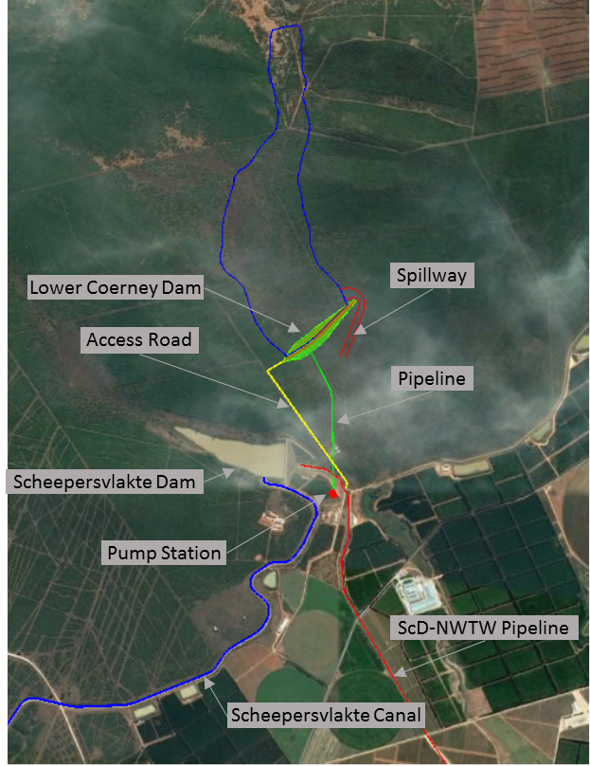
Lower Coerney Dam
The main advantage of this scheme is that it would provide a gravity supply to the WTW via the existing Nooitgedagt pipeline and it can also be filled by gravity flow via a proposed pipeline from the canal.

Slide 12
  Lower Coerney Dam
Main features of proposed dam:
Zoned embankment with cobblecrete slope protection
Concrete-lined side channel spillway - safety evaluation flood of about 890 m³/s
Include 180,000 m³ storage for 1 week of storage for irrigation of 750 ha Scheepersvlakte Farms orchards
Connecting pipelines
No pump station required

Slide 13
  Lower Coerney Dam
Advantages
Situated close to ScD and associated conveyance infrastructure
Gravity supply to fill dam and deliver water to NWTW (no pumping)
Capital cost and operational cost is lowest of five options investigated
Irrigation water passing through dam would probably be sufficient to maintain acceptable salinity for urban use. However no electricity costs would be incurred if water must be abstracted and replaced to maintain acceptable salinity levels
Disadvantages
Relatively large dam catchment area and a major flood could cause damage downstream of the spillway as there is no evidence of rock at the site
The storage would be far from NWTW and an additional siphon under the Sundays River would be required to reduce risk of failure of the system
Potential joint ownership and operation of the dam by the Municipality and the private developer might cause some complications

Slide 14
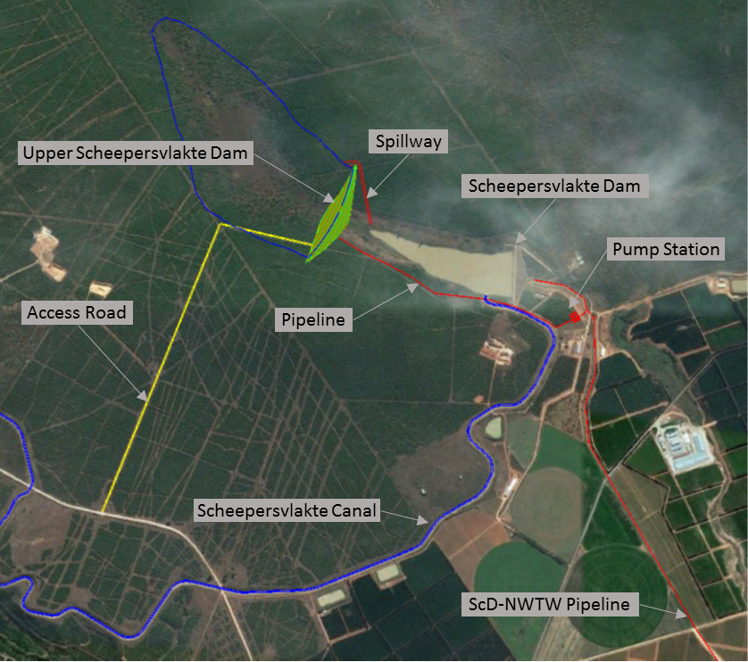
Upper Scheepersvlakte Dam

Slide 15
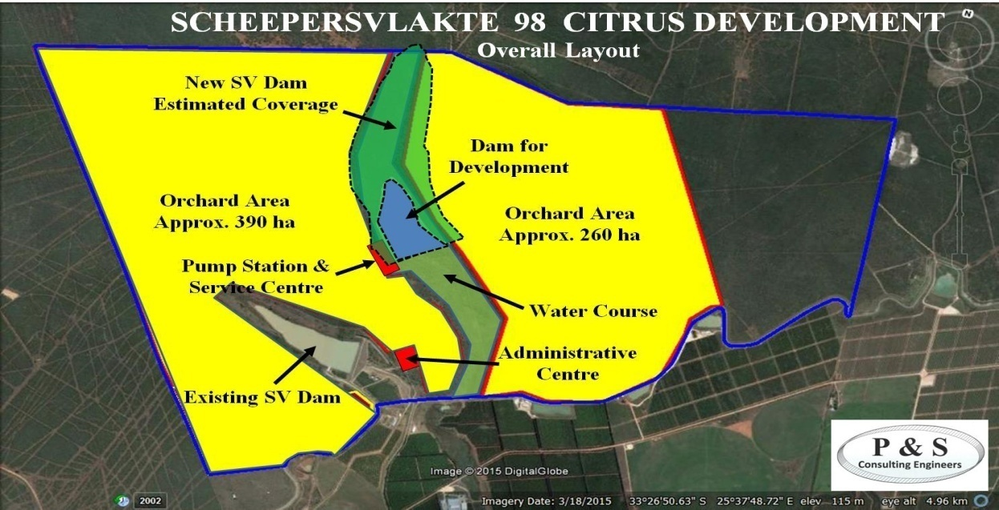
Construction of a larger dam near the present Scheepersvlakte Dam site

Slide 16
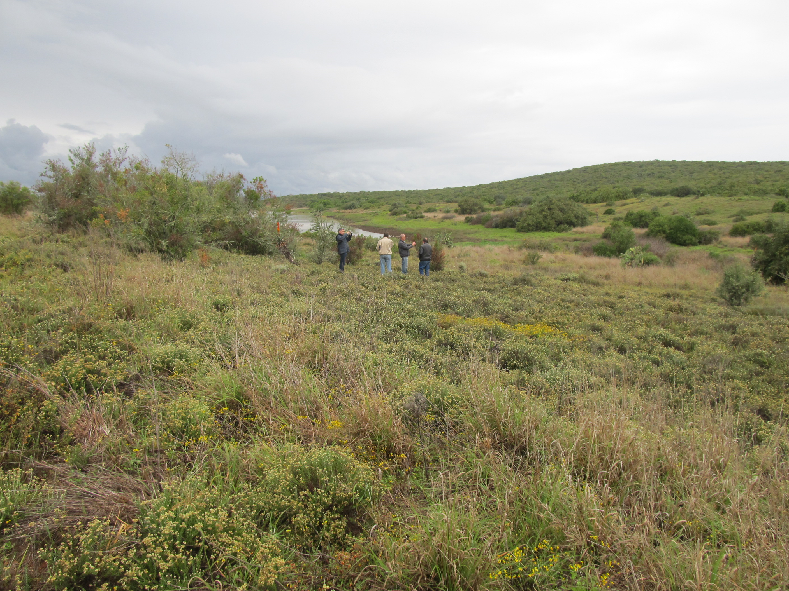
Upper Scheepersvlakte site
Notes:
21 days - This is based on the risk of failure of the old canal systems, as highlighted by the recent failure of a 100 m long section of the main canal on 17 May 2017, as well as the age of the Korhaansdrift Weir structure.

Slide 17
  Upper Scheepersvlakte Dam
Main features of proposed dam:
Zoned earthfill embankment dam with cobblecrete u/s slope protection
Safety evaluation flood accommodated by a small 10 m wide side channel spillway
Connecting pipework
Pump station located below Scheepersvlakte Dam

Slide 18
  Upper Scheepersvlakte Dam
Advantages
Situated very close to existing ScD and associated conveyance infrastructure
Dam catchment area is small, therefore a smaller spillway and less freeboard required
Disadvantages
Water stored in dam would have to be pumped from the canal = additional operational cost
Situated on private property to be developed as orchards by Scheepersvlakte Farms
Developer may wish to share use of the dam, which might complicate its operation
A pump station, remote from the NWTW, would have to be operated and maintained and an additional siphon under the Sundays River would be required to reduce the risk of failure of the system
ScD-NWTW pipeline may be vulnerable to damage by a major flood

Slide 19
Geotech & Topo surveys
Geotechnical survey for Lower Coerney and Upper Scheepersvlakte sites:
  Bush clearing - completed
  Geophysical survey – 2 weeks, underway
  Rotary core drilling – 3 weeks (mid-May)
  Test pitting – 3 days
  Laboratory testing – 3 to 4 weeks
  Data analysis, interpretation and reporting – 2 weeks
Topographical survey for Lower Coerney and Upper Scheepersvlakte sites – underway
Feasibility design of selected option – to commence once final site has been selected
Notes:
The geophysical survey would be conducted by a specialist geophysicist. Resistivity profiles would be carried out along the respective dam centre-lines, and will include traverses along a dam cross section as well as along the proposed spillway chute. The prime aim of these geophysical surveys would be to obtain a first impression of the geological profile, and to identify anomalies that would be targeted by subsequent rotary core drilling.
Rotary core drilling will aim to investigate the anomalies identified by the geophysics, as well as confirming the general geological profile and the founding conditions. The boreholes will further obtain samples for subsequent geotechnical testing, as well as provide opportunity for in situ geotechnical testing. Some specific structures (e.g. the intake tower) will also be targeted by drilling to confirm the founding conditions. Note that more detailed information on quantities is available as it has been included in the bill of quantities for costing purposes.
Test pits will be carried out on the dam embankment footprint, including the spillway chute, as well as in the reservoir area. The main aim of the test pits is to allow detailed observation and logging of the soil profile as well as an opportunity for the collection of samples for laboratory testing.
Selected representative samples will be submitted to SANAS-accredited laboratories for geotechnical testing. Both soil and rock core samples will be tested to determine their geotechnical parameters.
The data gathered from the field work, including the laboratory testing, will be interpreted and analysed. This information will be presented in the Geotechnical Report.

Slide 20
Quantification of Potential Water Savings

Slide 21
Temporary allowance for canal losses in the GFRWUA
A letter (1977) by the then Ministry of Water Affairs and Forestry notified allowance
Allowance for an additional 25% compensation (instead of 15%) for canal losses was intended to be a temporary measure for the GFRWUA, to be reduced to a more suitable allowance in the future
In 1977/78 when this temporary allowance for losses was made, there was still a significant surplus of water in the Orange River Basin. As the Orange River basin is now in deficit, it is essential this be revisited.

Slide 22
Recommendations
1. Reduce allowance for canal losses in GFRWUA
Incrementally reduce the allowance made for canal losses as originally intended.
Irrigators reduce canal losses by effectively maintaining the canals and removing vegetation along the canal edges, especially in the “hot spot” areas where large canal losses occur.
This intervention could potentially be implemented by:
  Incrementally reducing the allowance for canal losses from the current 25% to 15% over a reasonable period of time to allow the irrigators to effectively implement appropriate WUE measures
  Providing for the irrigators to pay an additional amount for the requested loss component above 15% canal losses, to be applied for WUE measures

Slide 23
Recommendations (cont.)
2. Reduce operational releases in the Lower Fish
Incrementally reduce the operational releases made at the Elandsdrift and De Mistkraal weirs over a suitable timeframe. After each incremental reduction, any practical operational constraints will be exposed, and can be addressed accordingly.

Slide 24
Recommendations (cont.)
3. Reduce spills at the Korhaansdrift Weir
The LSRWUA have improved the operation of the Darlington Dam further to keep the spills at the Korhaansdrift Weir to a minimum, especially over the weekend periods
It is noted that the optimal solution to the leakage at the Darlington Dam is to fix the leaking gates

Slide 25
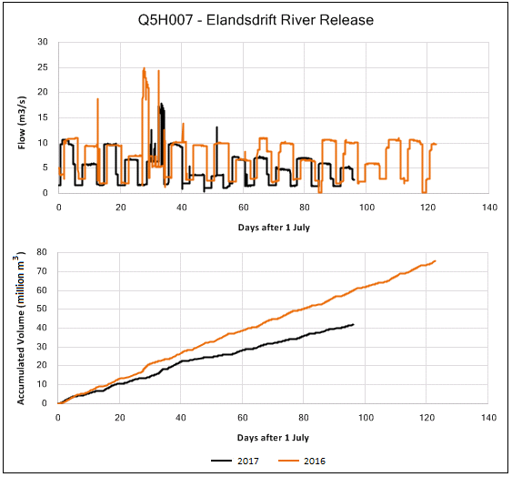
Recommendations (cont.)
4. Improve measuring and monitoring
Improvements to the GFRWUA
Improvements to the LSRWUA
Effective use of the OFS Operational Model
Notes:
Figure ‎4.1 shows the reductions in flow releases at the Elandsdrift Weir (about 18 million m3) between 1 July and 5 October 2017 compared to the same period from 2016. This highlights the effectiveness of using the model to optimise operations of the OFS Transfer Scheme, and emphasises the need for the effective use of the model going forward.

Slide 26
Recommendations (cont.)
5. Rehabilitation of the Darlington Dam
The DWS is currently planning to undertake the rehabilitation of the Darlington Dam, however the project is not underway yet

Slide 27
Recommendations (cont.)
6. Other general recommendations
No. | Recommendation | Description
1 | Further investigations into “hot spot” canal areas | A high-level assessment of Google Earth imagery was undertaken, and it is estimated that about 10% of the earth canal system are high-seepage priority areas. The next step would be to determine the location and extent of priority sections using more advanced tools, such as satellite imagery, to pick up soil moisture contents. A pilot test case may be useful to ascertain potential water savings and associated costs.
2 | Water Use Efficiency Accounting Reports | The DWS (D: WUE) is currently only receiving WUEA reports for 9 of the canals in the GFRWUA. Adequate measuring systems are not in place to report on all of the canals in the GFRWUA. Reiterates the need to implement the improvements to measuring and monitoring systems.

Slide 28
Recommendations (cont.)
6. Other general recommendations
No. | Recommendation | Description
3 | Allocations to resource-poor farmer schemes | At the Tyhefu Irrigation Scheme, about 19 million m³/a is “locked up” in unused allocations. The under-utilisation of the water allocations and existing infrastructure, despite efforts to rehabilitate the Scheme in the past, likely indicates that the farming models used were not sustainable. Other RPF schemes have been successfully implemented, e.g. in the Lower Sundays. Recommended that RPF schemes follow a similar approach to the proven, more sustainable RPF developments (e.g. in the Lower Sundays in an already developed scheme) to ensure that RPFs have the best possible chance of success.
Notes:
In the Lower Sundays, the RPF farms are:
Located on suitable land for agriculture.
Nested in an already-thriving agricultural area, and typical citrus crops grown in the area are economically feasible.
Can be integrated into existing functional bulk water supply infrastructure and management institutions.
Joint-venture approach provides continuous support and guidance for HDIs.

Slide 29
Principals for Allocation (cont.)
The potential water savings are dependent on the recommended WUE interventions being effectively implemented according to the proposed timeframe, without unforeseen practical limitations.
The actual water savings realised due to the implementation of the various WUE interventions should be continuously monitored and the estimates of potential future water savings should be adjusted accordingly.

Slide 30
Principals for Allocation (cont.)
Recommend that identified small towns in the study area apply for additional future allocations from the OFS Transfer Scheme, as these towns do not currently have alternative sources of water supply
Notes:
The total growth in water requirements for the small towns is estimated at 7 million m³ between 2014 and 2040, which equates to an additional requirement of 0.27 million m³ each year from 2014 to 2040.
It is recommended that these small towns implement effective WC/WDM measures in order to improve municipal water use efficiency, as recommended in the relevant updated All Towns Strategies.

Slide 31
Principals for Allocation (cont.)
Water which is currently wasted due to non-optimal operation of the OFS Transfer Scheme should not be considered for allocation, and therefore the potential reduction in “wasted” water will result in this water remaining in the Orange River catchment.
All other potential water savings through efficiency measures which are not allocated to the small towns or to the NMBM should result in this water remaining in the Orange River catchment.

Slide 32
Timeframe
No | Intervention | Timeframe | 2040 Target
1 | Reduce the allowance for canal losses in the GFRWUA | Reduce allowance by 1% every year | 40
2 | Reduce operational releases at the Elandsdrift and De Mistkraal weirs | Target 10% of potential savings every year | 31
3 | Reduce spills at the Korhaansdrift Weir | Target 10% of potential savings every year | 18
4 | Improve measuring and monitoring systems | Continuous | Not quantified
 | Total |  | 89

Slide 33
Targeted savings
Water user | 2040 Target
Reduced Orange River transfer volume to Eastern Cape | 64
Small towns to apply for further allocations | 7
NMBM to apply for further allocations | 18
Total to consider for further allocations | 25

Slide 34
- Thank you -

Slide 35
Additional Slides

Slide 36
  Lower Coerney Dam
Estimated capital costs (excl. VAT) of the proposed scheme:
Item | Estimated Cost
Lower Coerney Dam | R 152 million
Pipelines | R 49 million
TOTAL | R 201 million

Slide 37
  Upper Scheepersvlakte Dam
Estimated capital costs (excl. VAT):
Item | Estimated Cost
Upper Scheepersvlakte Dam | R 129 million
Pipelines | R 60 million
Pump Station | R 116 million
TOTAL | R 306 million

